Slide 1
Molecular similarity analysis in virtual screening
Xin Hu

Slide 2
Introduction
Virtual screening – Computational or in silico analog of biological screening
Score, rank, and/or filter a set of structures using one or more computational procedures
Helps decide:
Which compounds to screen
Which libraries to synthesize
Which compounds to purchase from an external source
Also used to analyze the results of HTS screening runs

Slide 3
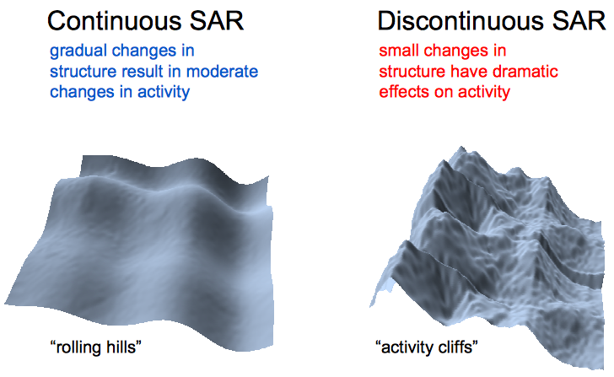
Molecular similarity and SARs(At the atomic level)
Small chemical changes in an active molecule can render it inactive or increase its activity dramatically
Molecular ‘activity landscapes’ as akin to either gently rolling hills or rugged canyons
http://infochim.u-strasbg.fr/CS3_2012/Lectures/Bajorath.pdf

Slide 4
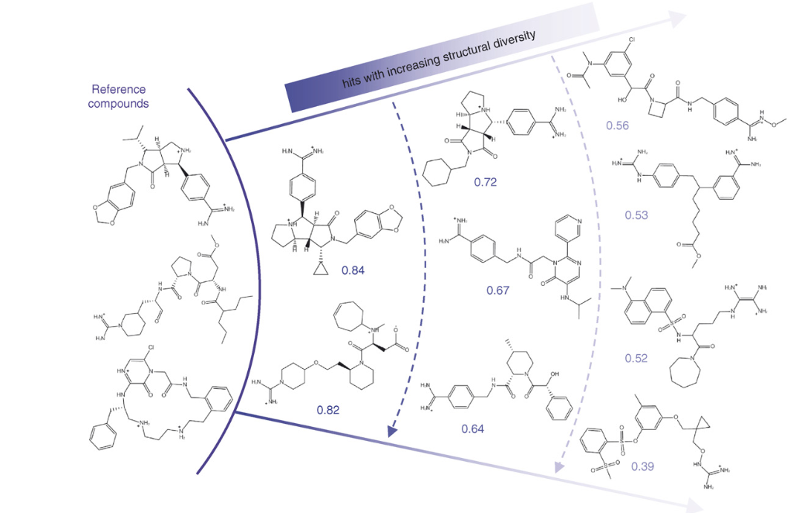
Molecular similarity and SARs - Example
A continuous SAR in which the structural similarity of active compounds gradually ‘fades away’ when departing from known leads
http://www.sciencedirect.com/science/article/pii/S1359644607000529
Notes:
Starting with known inhibitors of thrombin, a sequence of hits ranging from close analogs to increasingly diverse structures was identified in a simulated LBVS campaign in a large screening database containing 1.4 million compounds. Left: three of the five reference molecules. Right: examples of hits identified in a selection set of 250 database compounds. Hits are arranged in layers of increasing structural diversity (top down, from left to right). As a measure of structural similarity, the Tanimoto coefficient.

Slide 5
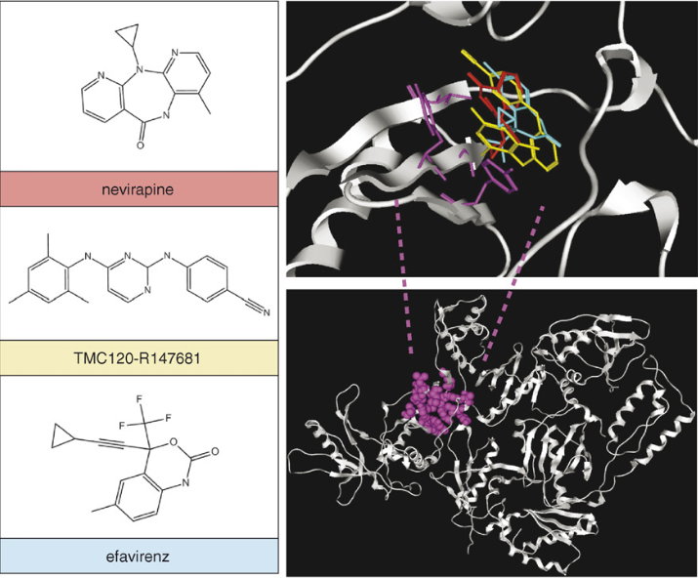
Molecular similarity and target–ligand interactions
Many ligand-binding sites are characterized:
a degree of structural plasticity
similar ligands can differ in binding conformation and/or orientation
Structurally distinct ligands can be accommodated in an adaptable binding site
Notes:
the structural divergence of inhibitors of HIV reverse transcriptase inhibitors can be rationalized on the basis of their different binding modes. In principle, the specific binding of different structural motifs to a target site is often indicative of a continuous SAR.

Slide 6
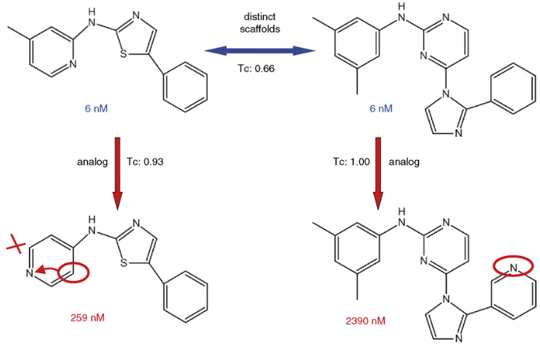
Heterogeneous SARs
SARs should be heterogeneous
Activity surfaces should contain both flat (continuous) and steep (discontinuous) regions
Similarity method must recognize the two nearly identical analogs as being similar
Notes:
1.The two inhibitors at the top are potent and bind with IC₅₀ values of 6 nM, although they have different core structures.
^{2.} subtle structural modifications of each inhibitor decrease their potency by two to three orders of magnitude.

Slide 7
Implications for similarity methods and
their relative performance
Similarity methods are fail: SARs are predominantly discontinuous and their activity radii are small
Different similarity methods rely on:
Different descriptors
Representations and reference spaces
Changing reference frames
Design novel algorithms and similarity methods:
Benefit from their complementary nature
Explore SARs more thoroughly

Slide 8
High-dimensional similarity methods
The approach of similarity searching is used in high dimensions
The reason:
The selection of features and the choice of distance is rather heuristic
Determining an appropriate nearest neighbor should be suffice for most practical purposes
Machine learning techniques:
Enriching selection sets for active compounds: SVM
Design of distance functions: distance in activity-centered chemical space (DACCS)
Mapping algorithms: dynamic mapping of consensus positions (DMC)
Simplified descriptor spaces of gradually increasing dimensionality

Slide 9
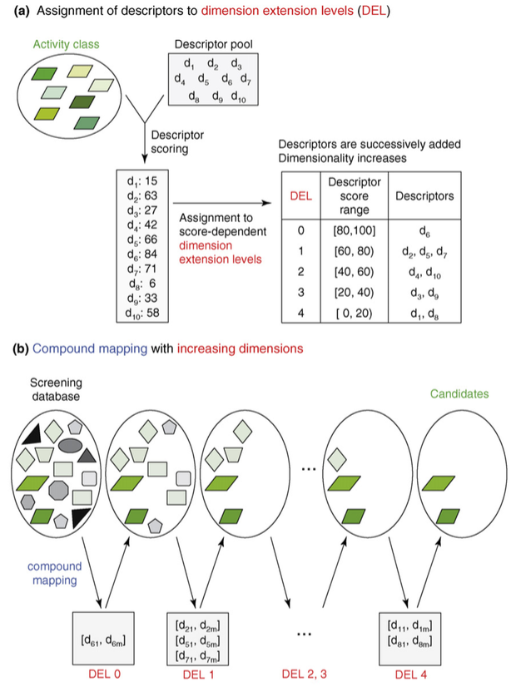
High-dimensional similarity methods
In benchmark calculations, DynaMAD recognized diverse structures having similar activity
Enrichment of active compounds in small selection sets

Slide 10
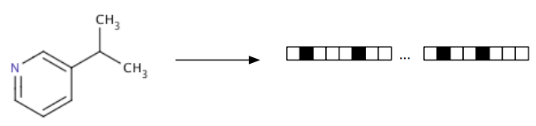
Molecular fingerprints
Idea: apply a kernel to a molecule to generate a bit vector or count vector(less frequent)
Typical kernels extract features of the molecule, hash them, and use the hash to determine bits that should be set
the best fingerprint for activities like virtual screening depends on the data set
Molprint 2D: Use a fingerprinting algorithm to minimize the number of calls to the sub-graph isomorphism library

Slide 11
3D similarity methods
2D or 3D molecular descriptors
3D-similarity methods
Methods:
Shape-matching algorithms
Shape-based fingerprints
3D-feature representations derived from cluster analysis of molecular conformations
Molecular field descriptors and pharmacophore fingerprints
Monitor potential pharmacophore arrangements in molecules
Transform local molecular views into a global view

Slide 12
Descriptor-independent similarity methods
String-based similarity searching : Reduced (or simplified) 2D molecular graph representations for similarity searching
MolBlaster methodology: Reduced graphs of molecules can be compared for overlap as a similarity criterion

Slide 13
Conclusions and future perspectives
Similarity-based methods are cornerstones of chemoinformatics and computer-aided pharmaceutical research
Benchmark calculations:
Low-dimensional and high-dimensional reference spaces
2D and 3D descriptors
Methods of low- and high- computational complexit
Similarity methods do have substantial ‘selectivity’ in recognizing diverse, active compounds
The complex nature of many SARs and the inherent approximation of similarity methods: finding active needles in chemical haystacks

Slide 14
Take home message
Most similarity methods depend on the use of predefined chemical descriptors and chemical reference spaces
The performance of diverse methods is limited principally by the nature of SARs, and that benchmark calculations provide artificial insights
Novel algorithms to navigate high-dimensional chemical spaces, train similarity calculations on specific compound classes, and detect remote similarity relationships

Slide 15
References
Hanna Eckert and Jürgen Bajorath, Molecular similarity analysis in virtual screening: foundations, limitations and novel approaches. Drug Discovery Today Volume 12, Numbers 5/6 March 2007
Cordella, L.P., Foggia, P., Sansone, C. & Vento, M. A (sub)graph isomorphism algorithm for matching large graphs. IEEE Transactions on Pattern Analysis and Machine Intelligence 26, 1367-1372 (2004). Ehrlich, H.-C. & Rarey, M. Systematic benchmark of substructure search in molecular graphs - From Ullmann to VF2. J Cheminf 4, 13 (2012).
http://infochim.u-strasbg.fr/CS3_2012/Lectures/Bajorath.pdf
http://www.sciencedirect.com/science/article/pii/S1359644607000529

Slide 16
Thank you

